Slide 1
CHAPTER 5
Identifying Good Measurement

Slide 2
Chapter Outline
Ways to measure variables
Reliability of measurement: Are the scores consistent?
Validity of measurement: Does it measure what it’s supposed to measure?
Review: Interpreting construct validity evidence
Notes:
These are the main sections of this chapter.
This chapter focuses on the construct validity of measured variables.

Slide 3
Ways to Measure Variables (1)
More about conceptual and operational variables
          Operationalizing “happiness”
    Operationalizing other conceptual variables
Notes:
Table 5.1: Variables and Operational Definitions
Several important decisions need to be made when measuring variables. The first one is how a variable should be operationalized. As you’ll recall from Chapter 3, any variable can be expressed in two ways: as a conceptual variable (aka construct or theoretical level) and as an operational variable (how the variable will be measured or manipulated).
The conceptual definition is the researcher’s definition of the variable in question at a theoretical level.
How can we operationalize “happiness”? A psychologist at the University of Illinois named Ed Diener (aka Dr. Happiness) has spent most of his career studying happiness. He started by creating a conceptual definition of happiness: “subjective well-being” (a person’s own perception of their well-being). Then Diener and colleagues came up with an operational definition by asking participants to respond to five items about their life satisfaction on a 7-point scale, with 1 corresponding to “strongly disagree” and 7 corresponding to “strongly agree.” This is one way of operationalizing subjective well-being, but there are other ways as well.
Operationalizing other conceptual variables: In order to study conceptual variables other than happiness, you would follow a similar procedure: (a) Define your construct (i.e., the conceptual variable). (b) Create an operational definition for your construct. (Instructor: You could choose one of the examples in Table 5.1 and walk through it, asking students to generate their own operational definitions.)
Copyright © 2025 W. W. Norton & Co., Inc.

Slide 4
Operationalization
How would you define…
  Extraversion?
  Anxiety?
  Aggression?

Slide 5
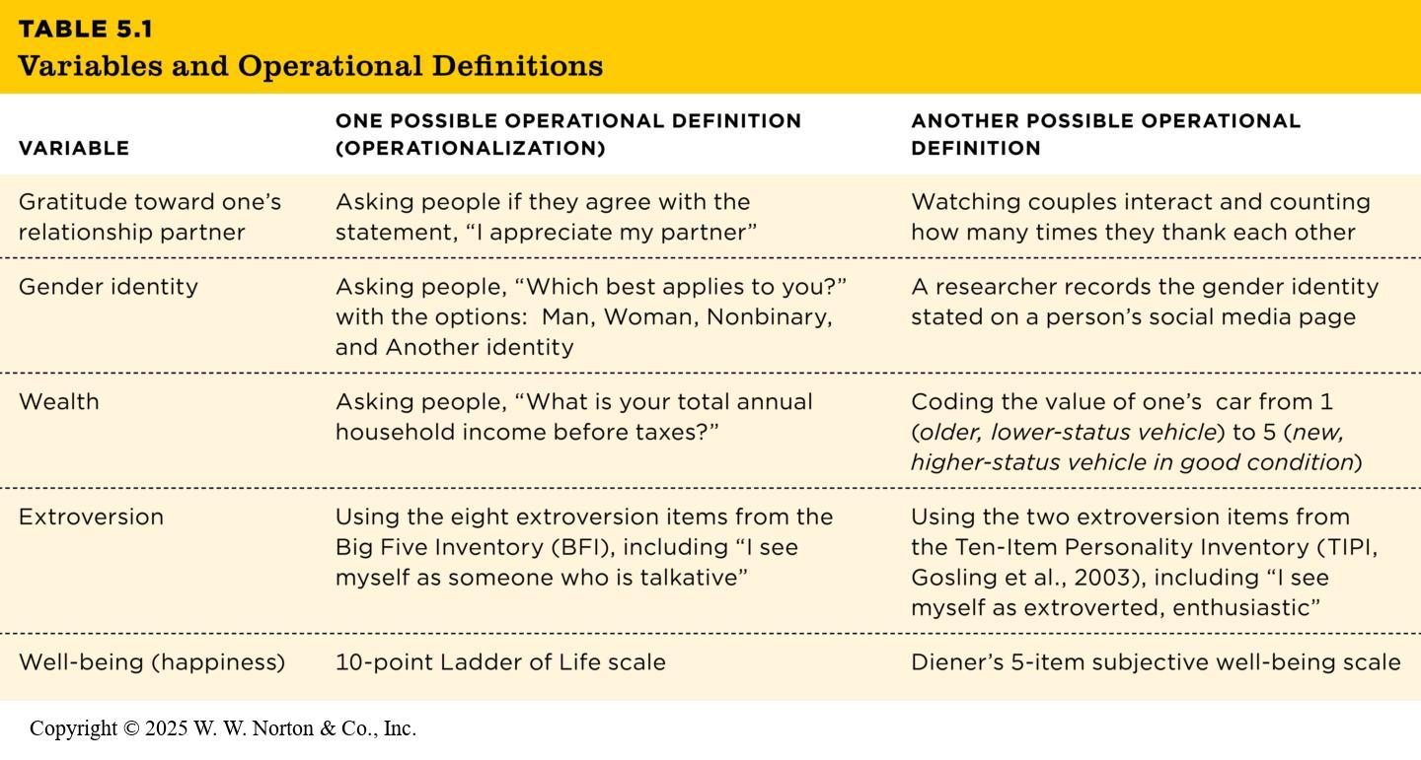
Ways to Measure Variables (2)
Table 5.1
TABLE 5.1 Variables and Operational Definitions
VARIABLE | ONE POSSIBLE OPERATIONAL DEFINITION (OPERATIONALIZATION) | ANOTHER POSSIBLE OPERATIONAL DEFINITION
Gratitude toward one’s relationship partner | Asking people if they agree with the statement, “I appreciate my partner” | Watching couples interact and counting how many times they thank each other
Gender identity | Asking people, “Which best applies to you?” with the options: Man, Woman, Nonbinary, and Another identity | A researcher records the gender identity stated on a person’s social media page
Wealth | Asking people, “What is your total annual household income before taxes?” | Coding the value of one’s car from 1 (older, lower-status vehicle) to 5 (new, higher-status vehicle in good condition)
Extroversion | Using the eight extroversion items from the Big Five Inventory (BFI), including “I see myself as someone who is talkative” | Using the two extroversion items from the Ten-Item Personality Inventory (TIPI, Gosling et al., 2003), including “I see myself as extroverted, enthusiastic”
Well-being (happiness) | 10-point Ladder of Life scale | Diener’s 5-item subjective well-being scale
Notes:
Table 5.1: Variables and Operational Definitions
Several important decisions need to be made when measuring variables. The first one is how a variable should be operationalized. As you’ll recall from Chapter 3, any variable can be expressed in two ways: as a conceptual variable (aka construct or theoretical level) and as an operational variable (how the variable will be measured or manipulated).
The conceptual definition is the researcher’s definition of the variable in question at a theoretical level.
How can we operationalize “happiness”? A psychologist at the University of Illinois named Ed Diener (aka Dr. Happiness) has spent most of his career studying happiness. He started by creating a conceptual definition of happiness: “subjective well-being” (a person’s own perception of their well-being). Then Diener and colleagues came up with an operational definition by asking participants to respond to five items about their life satisfaction on a 7-point scale, with 1 corresponding to “strongly disagree” and 7 corresponding to “strongly agree.” This is one way of operationalizing subjective well-being, but there are other ways as well.
Operationalizing other conceptual variables: In order to study conceptual variables other than happiness, you would follow a similar procedure: (a) Define your construct (i.e., the conceptual variable). (b) Create an operational definition for your construct. (Instructor: You could choose one of the examples in Table 5.1 and walk through it, asking students to generate their own operational definitions.)
Copyright © 2025 W. W. Norton & Co., Inc.

Slide 6
Three Common Types of Measures
  Self-report measure
  Observational measure
  Physiological measure
Notes:
Figure 5.1: Images from fMRI Scans Showing Brain Activity
In this study of how people respond to rewards and losses, the researchers tracked blood flow patterns in the brain when people had either won, lost, or tied in a rock-paper-scissors game played with a computer. They found that many regions of the brain respond more to wins than to losses, as indicated by the highlighted regions. (Source: Vickery et al., 2011.)
Operational definitions typically fall into three categories: self-report, observational, and physiological measures.
Self-report measures: Operationalize a variable by recording people’s answers to questions about themselves in a questionnaire or interview; for example, operationalizing caffeine consumption by asking, “How many caffeinated beverages have you consumed today?”
Observational measures (aka behavioral measures): Operationalize a variable by recording observable behaviors; for example, operationalizing allergies by observing how often someone sneezes, or using physical traces of behavior—as when operationalizing cleanliness by quantifying how much dust someone has on their furniture.
Physiological measures: operationalize a variable by recording biological data (e.g., brain activity, hormonal levels, heart rate); for example, operationalizing whether someone can distinguish between two different speech sounds by examining their brain responses to those speech sounds.
Which operationalization is best? A single construct can be operationalized in all three ways, and one way is not necessarily better than another. However, it’s preferable that the three types of measures show similar patterns of results.
Vickery et al. (2011). Ubiquity and specificity of reinforcement signals throughout the human brain. Neuron 72(1): 166–177 © 2011 Elsevier

Slide 7
Scales of Measurement (1)
Categorical vs. quantitative variables
    Categorical variables
    Quantitative variables
Notes:
Table 5.2: Measurement Scales for Operational Variables
All variables must have at least two levels to allow for change (so they can vary). The levels of operational variables can be coded using different scales of measurement.
The primary distinction is between categorical variables and quantitative variables.
Categorical variables (aka nominal variables): their levels are qualitatively distinct categories; for example, species (rhesus macaque, bonobo, chimpanzee).
Quantitative variables: variables coded with meaningful numbers; for example, height, weight, or scale of subjective well-being.
There are three types of quantitative variables.
Ordinal scale: Ranked order (first, second, and third places in a race—first place isn’t twice as fast as second place).
Interval scale: Numerals represent equal distances between levels, and there is no true zero (zero does not mean “nothing”)
Ratio scale: Numerals represent equal intervals and there is a true zero, for example, height or exam scores.
Copyright © 2025 W. W. Norton & Co., Inc.

Slide 8
Scales of Measurement (2)
Types of quantitative variables
    Ordinal scale
    Interval scale
    Ratio scale
Notes:
Table 5.2: Measurement Scales for Operational Variables
All variables must have at least two levels to allow for change (so they can vary). The levels of operational variables can be coded using different scales of measurement.
The primary distinction is between categorical variables and quantitative variables.
Categorical variables (aka nominal variables): their levels are qualitatively distinct categories; for example, species (rhesus macaque, bonobo, chimpanzee).
Quantitative variables: variables coded with meaningful numbers; for example, height, weight, or scale of subjective well-being.
There are three types of quantitative variables.
Ordinal scale: Ranked order (first, second, and third places in a race—first place isn’t twice as fast as second place).
Interval scale: Numerals represent equal distances between levels, and there is no true zero (zero does not mean “nothing”)
Ratio scale: Numerals represent equal intervals and there is a true zero, for example, height or exam scores.
Copyright © 2025 W. W. Norton & Co., Inc.

Slide 9

Four Scales of Measurement (1)
Scaling: linking of numbers to behavioral observations.
Stanley Stevens (1946): Four levels of measurement.
  Most popular framework
Notes:
Scaling: Refers to the way in which numbers are linked to behavioral observations to create a measure.
Controversial nature of the definition:
The definition of scaling is controversial and continues to be so.
Some experts believe scaling is defined liberally and restrict scaling to the assignment of numbers that, at a minimum, have the property of order.
Other opt an even more restrictive definition that requires the use of scalars.
Four levels of measurement: Stevens has identified four levels of measurement in a popular framework: nominal, ordinal, interval, and ratio.

Slide 10
Four Scales of Measurement (2)
Nominal Scales
Use of numbers with property of identity to label observations.
Example: sorting of children in classroom.
  Distinguishing the labels.
  Clear understanding of the scales.
Notes:
Nominal scale:
Nominal scale of measurement is the most fundamental level of measurement.
In this scale, the numbers with the property of identity are used to label observations in which behaviours have been sorted into categories according to some psychological attribute.
Example: sorting of children in classroom:
A classroom of children can be sorted into two groups: Group 1 with children have behavioral problems and Group 2 identifies with children without behavioral problems.
Our concern here would be to ensure that both groups are exhaustive and mutually exclusive.
Distinguishing the labels:
Nominal scale labels must be distinguished from labels used to identify or name individuals.
Nominal scale labels indicate groups with common attributes while label used to identify individuals (example: social security numbers) do not attempt to establish a group.
Clear understanding of the scales:
While using numerals to identify individuals, one must clear about the purpose of doing so.
In other words, the use of numerals to identify group membership or to essentially serve as names for individuals must be made clear.

Slide 11
Four Scales of Measurement (3)
Ordinal Scales
Possessing the property of order.
Indicating the relative position.
Level of information conveyed.
Notes:
Possessing the property of order:
The ordinal scale of measurement involves using numerals that have the property of order.
In other words, this scale ranks people according to the level of attribute they possess.
Example: Athletes of a team can be ranked rank 1, rank 2, and so on based on their athleticism.
Indicating the relative position:
The ordinal scale indicates the relative position of an individual in a group based on the degree to which the individual possess a psychological attribute.
Nevertheless, there is no mention on how much of that psychological attribute is possessed by the individuals.
Level of information conveyed:
Ordinal scale of measurement offers most information than the nominal scale.
However, it has its limitations too.
Two different groups of individuals, ranked within their own but on the same psychological attribute cannot be compared.
For example: Individual with Rank 1 from one group may not possess the same extent of the attribute as the Rank 1 individual of the other group.

Slide 12
Four Scales of Measurement (4)
Interval Scales
Characterized by property of quantity.
Arbitrary zero in interval scales.
Tests that yield interval-level scores:
  IQ tests, personality tests, academic achievement tests (SAT, ACT, etc.)
Notes:
Interval scales:
Both interval and ratio scale of measured are characterized by the property of quantity.
The difference between them arises primarily from the meaning of zero.
Arbitrary zero in interval scales:
Interval scales have an arbitrary zero, that is, the zero does not represent the absence of any attribute.
Example: Temperature expressed in Celsius.
Multiplicative interpretations are not allowed:
In the interval scale of measurement, the size of the units are constant and additive.
However, multiplicative interpretations are not possible.
For instance, the amount of heat needed to change temperature from 40 to 42°C is the same as that needed to change from 80 to 82°C. But it would be incorrect to say that 80°C as having “twice as much heat” or being “twice as warm” as 40°C.
Tests that yield interval-level scores:
Several tests like intelligence tests, personality tests, achievement tests, and so on are measured using the interval scales.
However, experts suggest that only a very few tests are truly said to yield interval-level scores. Example: the academic assessment test, SAT.

Slide 13
Four Scales of Measurement (5)
Ratio Scales
Have absolute zero point.
  Examples: Distance, Height, Weight, etc.
Issue in interpretation of differences.
  Multiplicative!
  May be impossible for someone to respond w/ zero
Understanding absolute zero point.
  Is zero a lack of response or a lack of the attribute?
Notes:
Ratio scale:
Interval scales come with an arbitrary 0 while ratio scales come with an absolute 0 point.
The zero in absolute scale can indicate the absence of attribute that is being measured. Example: distance.
Level of information:
Ratio scales allow more information and more sophisticated inferences that the other three scales.
This includes additivity as well as multiplicative interpretations.
Issue in interpretation of differences:
The fact that additivity and multiplicative interpretations are allowed in ratio scales gives rise to the issue of interpretation.
This issue arises between applied settings and research settings.
While it may come as a surprise, some researchers believe that no test can yield ratio-level data in psychology.
Understanding absolute zero point:
As mentioned earlier, absolute zero is a possibility in ratio scales.
However, it may be impossible for a person to respond to anything in 0 s.
The point to be noted here is that test users must distinguish between the zero associated with a measuring device and the zero associated with characteristics of the psychological attribute that we are measuring.

Slide 14
Reliability of Measurement: Are the Scores Consistent?
Introducing three types of reliability
Using a scatterplot to quantify reliability
Using the correlation coefficient (r) to evaluate reliability
Reading about reliability in journal articles
Notes:
This slide presents the section headings.
Reliability: how consistent the results of a measure are
Validity: whether it’s actually measuring the construct it’s supposed to measure

Slide 15
Three Types of Reliability
  Test-retest reliability
  Interrater reliability
  Internal reliability
Notes:
There are three types of reliability.
Test-retest reliability: Consistent scores every time the measure is used; for example, give an IQ test at Time 1 (T1), at the beginning of the semester, and again at Time 2 (T2), at the end of the semester. The scores should be relatively consistent across the two times.
Interrater reliability: Consistent scores no matter who does the measuring; for example, two observers measure how happy a child is, and their counts are consistent with one another.
Internal reliability (aka internal consistency): A participant provides a consistent pattern of responses, regardless of how the researcher has phrased the question; for example, a researcher asks in several different ways about how lonely you feel, and your responses are consistent with one another.

Slide 16
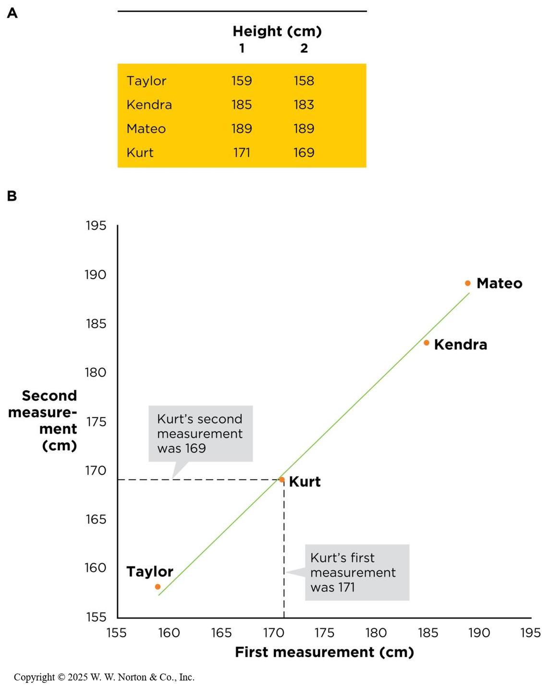
Using a Scatterplot to Evaluate Reliability
Notes:
Figure 5.2: Two measurements of height, showing reliability.
(A) The data for four participants in table form. (B) The same data presented in a scatterplot.
The scatterplot shows the first measurement of each person, plotted on the x-axis. The second measurement is plotted on the y-axis. Each dot represents one person measured twice. A scatterplot like this, with most dots falling near a positively sloped line, indicates that our height measure is reliable.
Copyright © 2025 W. W. Norton & Co., Inc.

Slide 17
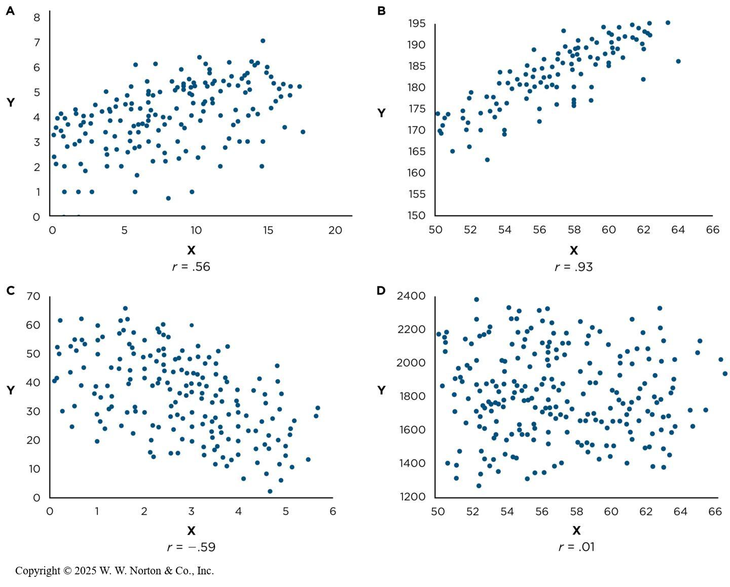
Correlations
To what extent are two variables related?
Measures the general pattern of responses
Notes:
Figure 5.3: Correlation Coefficients
Notice the differences in the correlation coefficient (r) in these scatterplots. The correlation coefficient describes both the direction and the strength of the association between the two variables, regardless of the scale on which the variables are measured.
Although scatterplots are a good first step in evaluating reliability, a more common and more efficient way is to use the correlation coefficient.
Correlation coefficient (r): This is a single number that describes how close the dots on a scatterplot are to the line drawn through them.
Slope direction: Notice that the direction of the slope is different in the four scatterplots. A and B show an upward slope from left to right (positive slope); C shows a downward slope (negative slope); and D does not slope either up or down (zero slope).
Strength: The spread of the dots in a scatterplot corresponds to the strength of the relationship. When dots are close to the line, you have a strong relationship. When dots are spread out, you have a weak relationship. When your slope is positive, r is positive. When your slope is negative, r is negative; r ranges from -1.0 to +1.0. The stronger the relationship, the closer r is to -1.0 or +1.0. The weaker the relationship, the closer r is to 0. An r of 1.0 is the strongest positive relationship, an r of -1.0 is the strongest negative relationship, and an r of 0 or close to 0 is no relationship.
How Do Psychologists Use the Strength and Direction of r to Evaluate Reliability?
Test-retest reliability: Measure the same participants at least twice (Time 1 and Time 2) and then compute r. If r is strong and positive (.05 or above), then you have good test-retest reliability. If r is positive but weak, it is a sign of low test-retest reliability. Note that test-retest reliability is only relevant for variables that do not change over time. It wouldn’t be relevant for something like an organism’s weight.
Interrater reliability: Two observers rate the same participants at the same time and then an r is computed. If r is positive and strong (.70 or higher), you have good interrater reliability. If r is positive but weak, you do not have good interrater reliability. A negative r would mean terrible interrater reliability. Can you explain why? When observers are rating a quantitative variable, r is the appropriate statistic. However, when a variable is categorical, the appropriate statistic is a kappa.
3. Internal reliability: This is relevant for measures that use more than one item to tap into the same construct. A set of items has internal reliability if its items correlate strongly with one another. In that case, you can average across those items to get a single overall score for each participant.
Cronbach’s alpha is the statistic usually used to evaluate internal reliability.
Copyright © 2025 W. W. Norton & Co., Inc.

Slide 18
Things to Know about the Correlation Coefficient
It varies between -1 and +1
  0 = no relationship
It is an effect size
  ±.1 = small effect
  ±.3 = medium effect
  ±.5 = large effect
Coefficient of determination, r²
  By squaring the value of r you get the proportion of variance in one variable shared by the other.

Slide 19
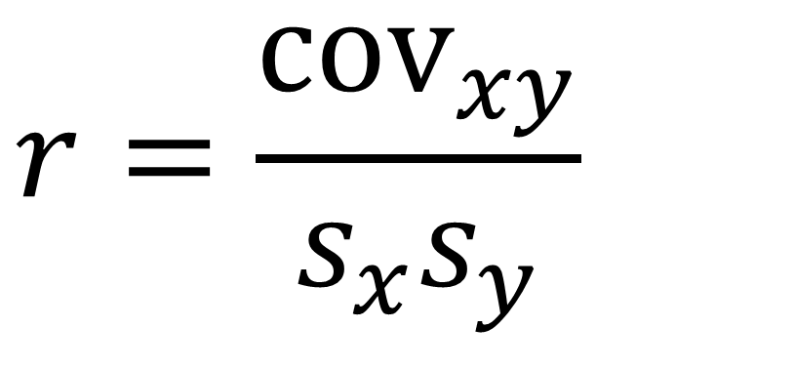
The Correlation Coefficient (Pearson’s r)
$$r=\frac{cov_{xy}}{s_{x}s_{y}}$$

Slide 20
Reliability
Reliability:
  Does the method consistently measure what is being studied?
  “Garbage in, Garbage out”
  Types:
    Test-retest
    Inter-rater reliability
    Internal reliability

Slide 21
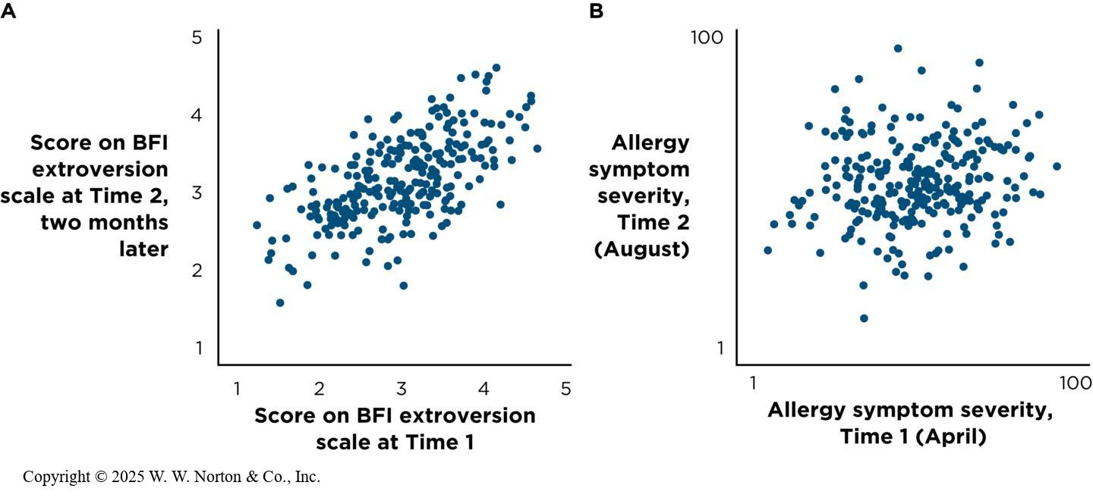
Test-retest Reliability
Notes:
Figure 5.4: Test-retest Reliability
To see if a scale has test-retest reliability, we test the same group of individuals twice, a few weeks or months apart. (A) Scores on a personality trait such as extroversion should show a strong correlation, indicating that they stay consistent over time. (B) Some traits, such as allergy symptoms, are expected to have low test-retest reliability because they are inconsistent over time.
Copyright © 2025 W. W. Norton & Co., Inc.

Slide 22
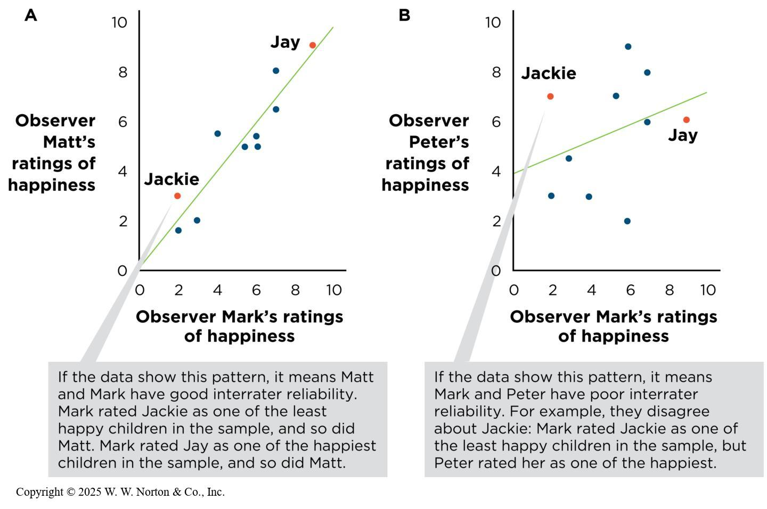
Interrater Reliability
Notes:
Figure 5.5: Interrater Reliability
(A) Interrater reliability is high. (B) Interrater reliability is low.
Scatterplots also can be used to examine interrater reliability.
Example: There are two pairs of observers (Mark and Matt and Mark and Peter). They are to rate 10 young children on a scale from 1 to 10 indicating how happy they are. In order to see how well their ratings agree, we can make a scatterplot with Mark’s ratings on the x-axis and Matt’s on the y-axis (the same can be done with Mark and Peter); higher interrater reliability is on the left (dots close to the slope line) and lower interrater reliability is on the right (dots further spread out from the slope line).
Copyright © 2025 W. W. Norton & Co., Inc.

Slide 23
Measuring Reliability
Cohen’s Kappa (κ)
  Accounts for chance agreement
  Two raters are classifying items into categories (e.g., yes/no, mild/moderate/severe).

Slide 24
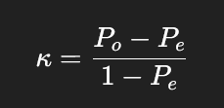
Cohen’s Kappa (1)
P_{o}​ = Observed agreement (the proportion of times the raters agreed)
P_{e} = Expected agreement by chance

Slide 25

Cohen’s Kappa (2)
100 observations
How many agree?
How may disagree?

Slide 26
Cohen’s Kappa (3)
A
B
C
D
Calculate Observed (P_{o})
Formula: (A + D) / n
P_{o} = ?

Slide 27
Cohen’s Kappa (4)
Calculate Expected (P_{e})
Use the margins!
Multiply Yes: .60 x .55 = .33
Multiple No: .40 x .45 = .18
Add: .33 + .45 = ?

Slide 28
Cohen’s Kappa (5)
κ = (.85 - .51) / (1 - .51)
κ = .694

Slide 29
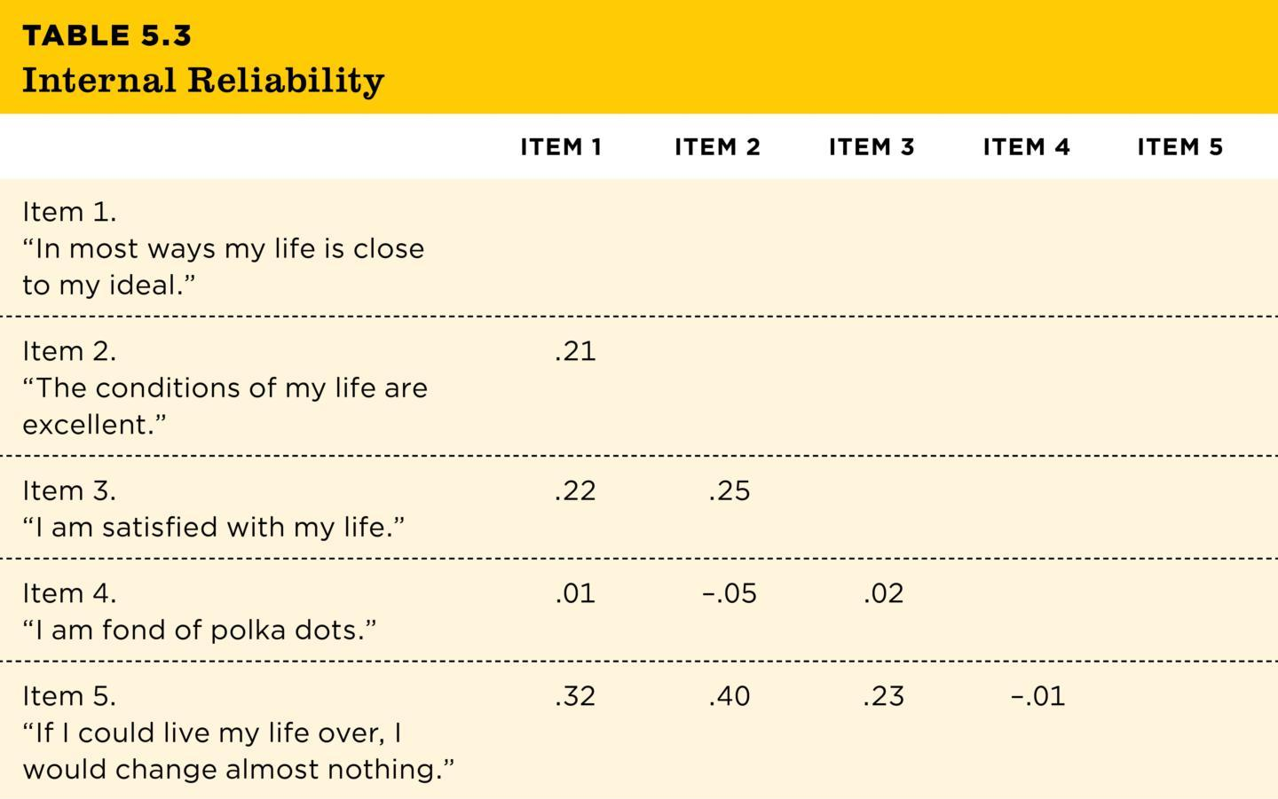
Internal Reliability
Average inter-item correlation (AIC)
Cronbach’s alpha
Table 5.3
TABLE 5.3 Internal Reliability
 | ITEM 1 | ITEM 2 | ITEM 3 | ITEM 4 | ITEM 5
Item 1. “In most ways my life is close to my ideal.”
Item 2. “The conditions of my life are excellent.” | .21
Item 3. “I am satisfied with my life.” | .22 | .25
Item 4. “I am fond of polka dots.” | .01 | –.05 | .02
Item 5. “If I could live my life over, I would change almost nothing.” | .32 | .40 | .23 | –.01
Note: This matrix shows the correlations among the five items listed on the well-being scale. To assess internal reliability, we start by computing the correlation of each item with every other item. To find the correlation, r, between two items, locate where one item’s column and another item’s row intersect (for example, the correlation between Item 1 and Item 3 is r = .22). You can see that Items 1, 2, 3, and 5 correlate with one another, but Item 4 (the one about polka dots) does not correlate with any of the other items. The pattern suggests that Item 4 is problematic and this set of items is not internally reliable. (Data are fabricated for illustration purposes.)
Notes:
Table 5.3: Internal Reliability
This table shows how researchers can test for internal reliability: by having people answer different versions of a question and measuring the correlation between how people responded to the different questions.
Average inter-item correlation (AIC) is the average of all the correlations between the different items.
Cronbach’s alpha is the statistic usually used to evaluate internal reliability.
If the AIC or Cronbach’s alpha is acceptable, then there is good internal reliability.
This matrix shows the correlations among the five items listed on page 130. To assess internal reliability, we start by computing the correlation of each item with every other item. To find the correlation, r, between two items, locate where one item’s column and another item’s row intersect (for example, the correlation between Item 1 and Item 3 is r = .22). You can see that Items 1, 2, 3, and 5 correlate with one another, but Item 4 (the one about polka dots) does not correlate with any of the other items. The pattern suggests that Item 4 is problematic and this set of items is not internally reliable. (Data are fabricated for illustration purposes.)
Copyright © 2025 W. W. Norton & Co., Inc.

Slide 30
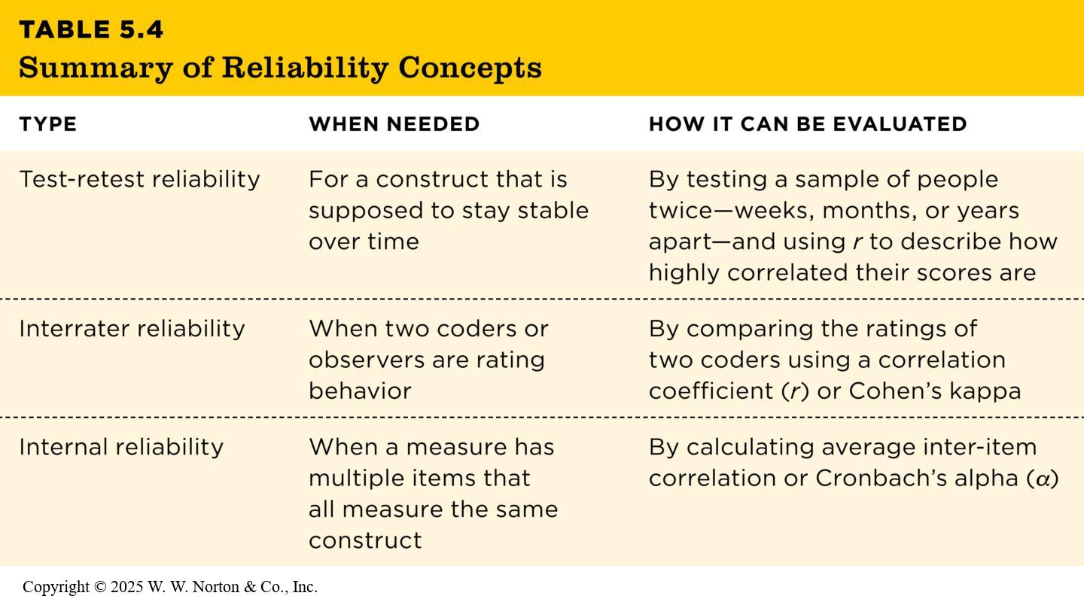
Summary of Reliability Concepts
Table 5.4
TABLE 5.4 Summary of Reliability Concepts
Type | When Needed | How It Can Be evaluated
Test-retest reliability | For a construct that is supposed to stay stable over time | By testing a sample of people twice—weeks, months, or years apart—and using r to describe how highly correlated their scores are
Interrater reliability | When two coders or observers are rating behavior | By comparing the ratings of two coders using a correlation coefficient (r) or Cohen’s kappa
Internal reliability | When a measure has multiple items that all measure the same construct | By calculating average inter-item correlation or Cronbach’s alpha (a)
Notes:
Table 5.4: Summary of Reliability Concepts
Table 5.4 summarizes the three forms of reliability.
Copyright © 2025 W. W. Norton & Co., Inc.

Slide 31
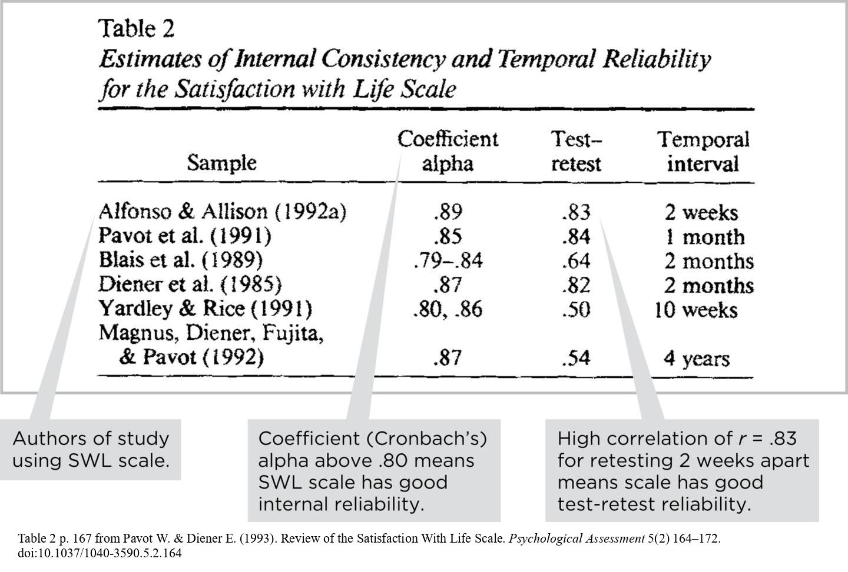
Reading About Reliability in Journal Articles
Notes:
Figure 5.6: Reliability of the Well-Being Scale
The researchers created this table to show how six studies supported the internal reliability and test-retest reliability of their SWL scale. (Source: Pavot & Diener, 1993, Table 2.)
Figure 5.6 presents reliability information for six studies. Look at coefficient alpha for internal reliability. Interrater reliability wasn’t examined because self-report measures were used. Conclusion: The subjective well-being score has very high internal reliability and test-retest reliability.
Table 2 p. 167 from Pavot W. & Diener E. (1993). Review of the Satisfaction With Life Scale. Psychological Assessment 5(2) 164–172. doi:10.1037/1040-3590.5.2.164

Slide 32

Validity of Measurement: Does It Measure What It’s Intended to Measure?
  Measurement validity of abstract constructs
  Face validity and content validity: Does it look like a good measure?
  Criterion validity: Does it correlate with key behaviors?
  Convergent validity and discriminant validity: Does the pattern make sense?
  Relationship between reliability and validity
Notes:
Figure 5.7: Reliability Is Not the Same as Validity
A bathroom scale may report that a person weighs 50 pounds (22.7 kg) every time they step on it. The scale is certainly reliable (specifically, it has test-retest reliability), but it is not valid.
Validity: This is an indication of whether the operationalization is measuring what it’s supposed to measure.
This slide presents the section headings.
Reliability is not the same as validity, but both are important in establishing construct validity; for example, height is an operationalization for extroversion. Height is a reliable measure, but it is not a valid measure of extroversion.
GagliardiImages/Shutterstock

Slide 33
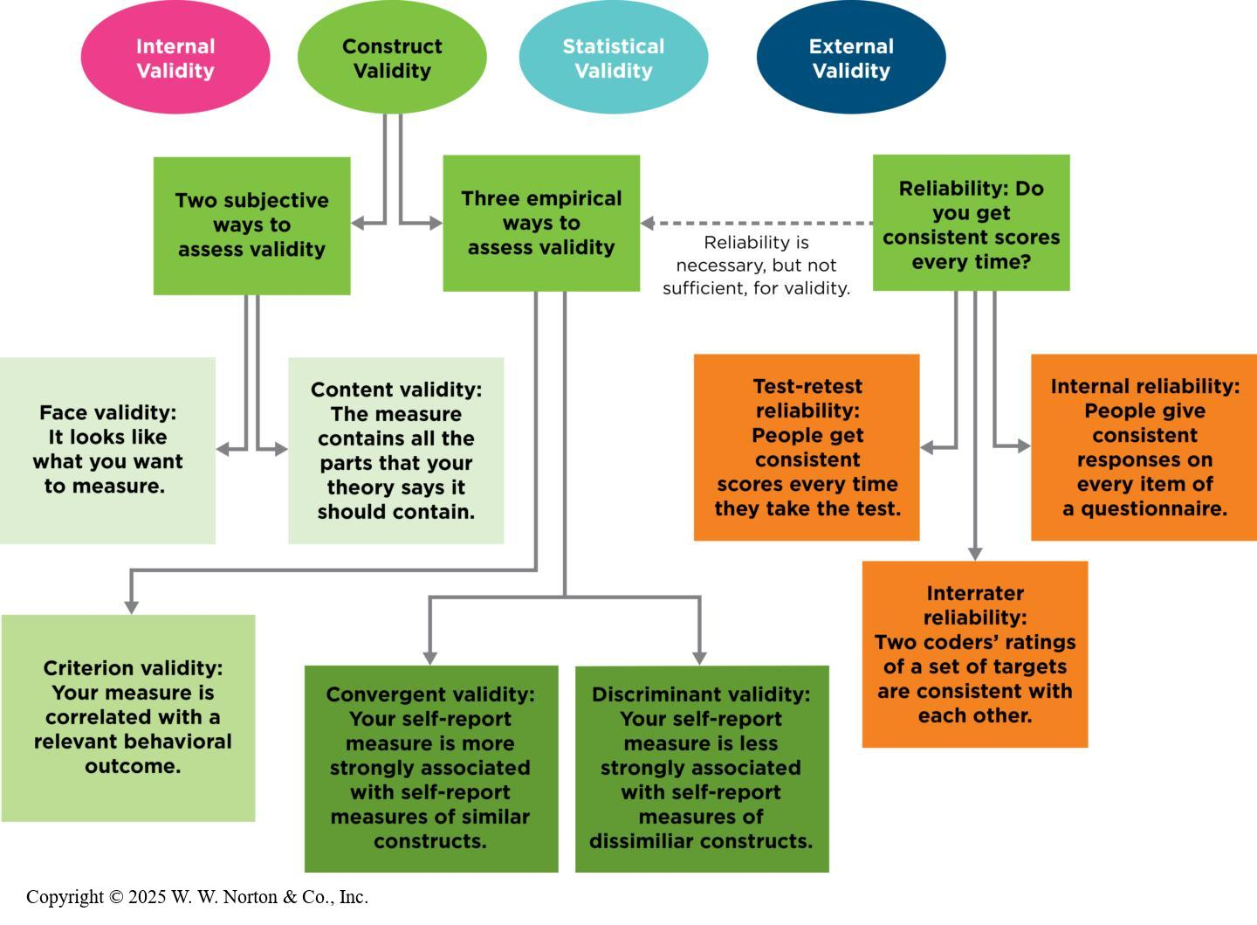
Measurement Validity of Abstract Constructs
Notes:
Figure 5.9: A Concept Map of Measurement Reliability and Validity
Construct validity is one of the four big validities, and it is supported by a variety of evidence.
Physical scientists have standards for measurement (e.g., rulers, scales, thermometers) to ensure that they are measuring things like length, weight, and temperature reliably.
However, psychological scientists are interested in measuring abstract constructs such as anger and self-esteem. Thus, construct validity is very important to psychological scientists.
Figure 5.9 is an overview of the reliability concepts that we have already covered in this chapter and the validity concepts that we will cover now.
Copyright © 2025 W. W. Norton & Co., Inc.

Slide 34
Face Validity and Content Validity: Does It Look Like a Good Measure?
  Both face validity and content validity are subjective ways to assess validity.
  Face validity: It looks like what you want to measure.
  Content validity: The measure contains all the parts that your theory says it should contain.
Notes:
Face validity: It looks like what you want to measure.
Content validity: The measure contains all the parts that your theory says it should contain.

Slide 35
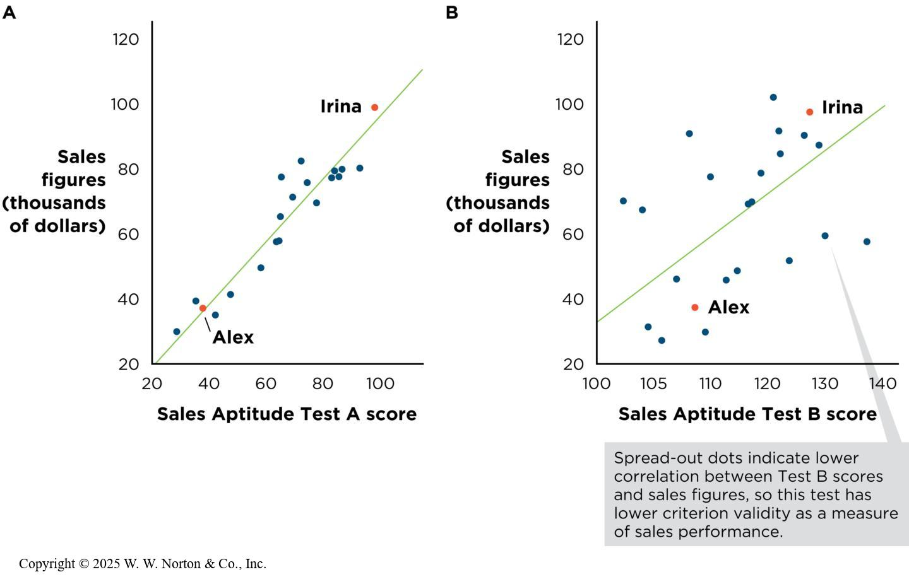
Criterion Validity: Does It Correlate with Key Behaviors?
  Correlational evidence for criterion validity
Notes:
Figure 5.10: Correlational Evidence for Criterion Validity
(A) Sales Aptitude Test A predicts sales performance, so criterion validity is high. (B) Sales Aptitude Test B does not predict sales as well, so criterion validity is lower. The company would probably want to use Test A for identifying potential selling ability when hiring new salespeople.
Most psychological scientists prefer to rely on empirical assessments of validity over subjective judgments. One way to empirically assess validity is by examining criterion validity (whether the measure is related to a concrete outcome that it should be related to).
Example: Suppose you work for a company that wants to predict how well job applicants would do as salespeople. Initially, the company used IQ to predict sales aptitude (see left-hand figure). Then the company developed a sales ability scale to predict sales aptitude (see right-hand figure). Aptitude Test A strongly predicts sales performance, so criterion validity is high. (B) Aptitude Test B does not predict sales as well, so criterion validity is lower. A company would probably want to use Test A for identifying potential selling ability when selecting salespeople.
Copyright © 2025 W. W. Norton & Co., Inc.

Slide 36
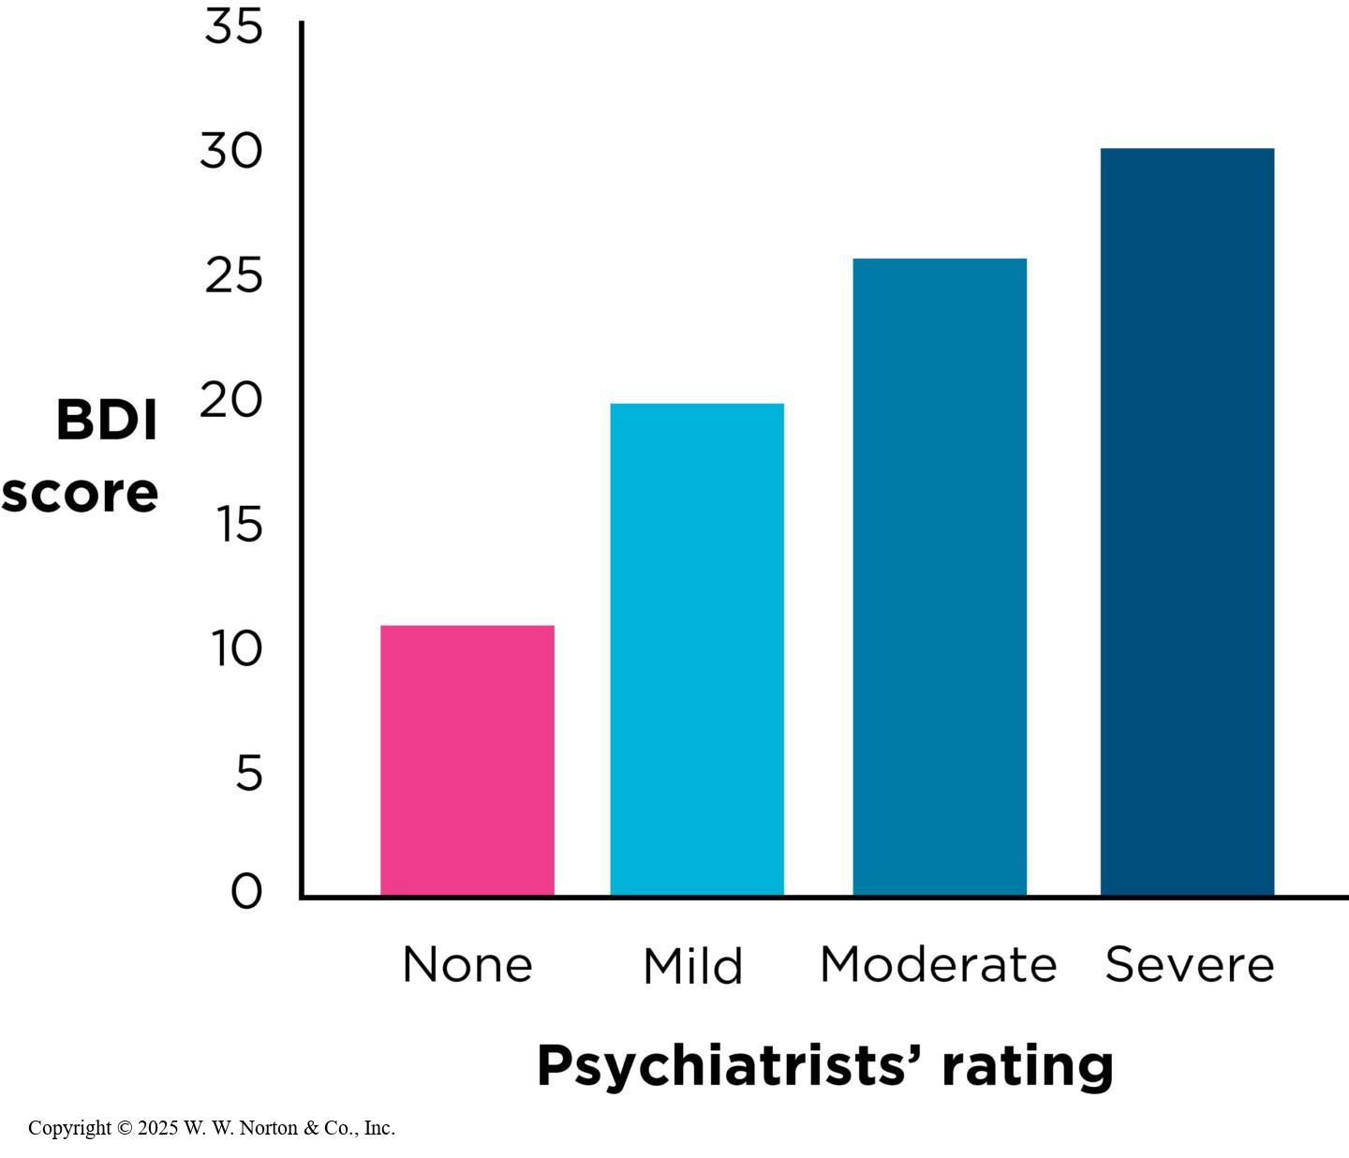
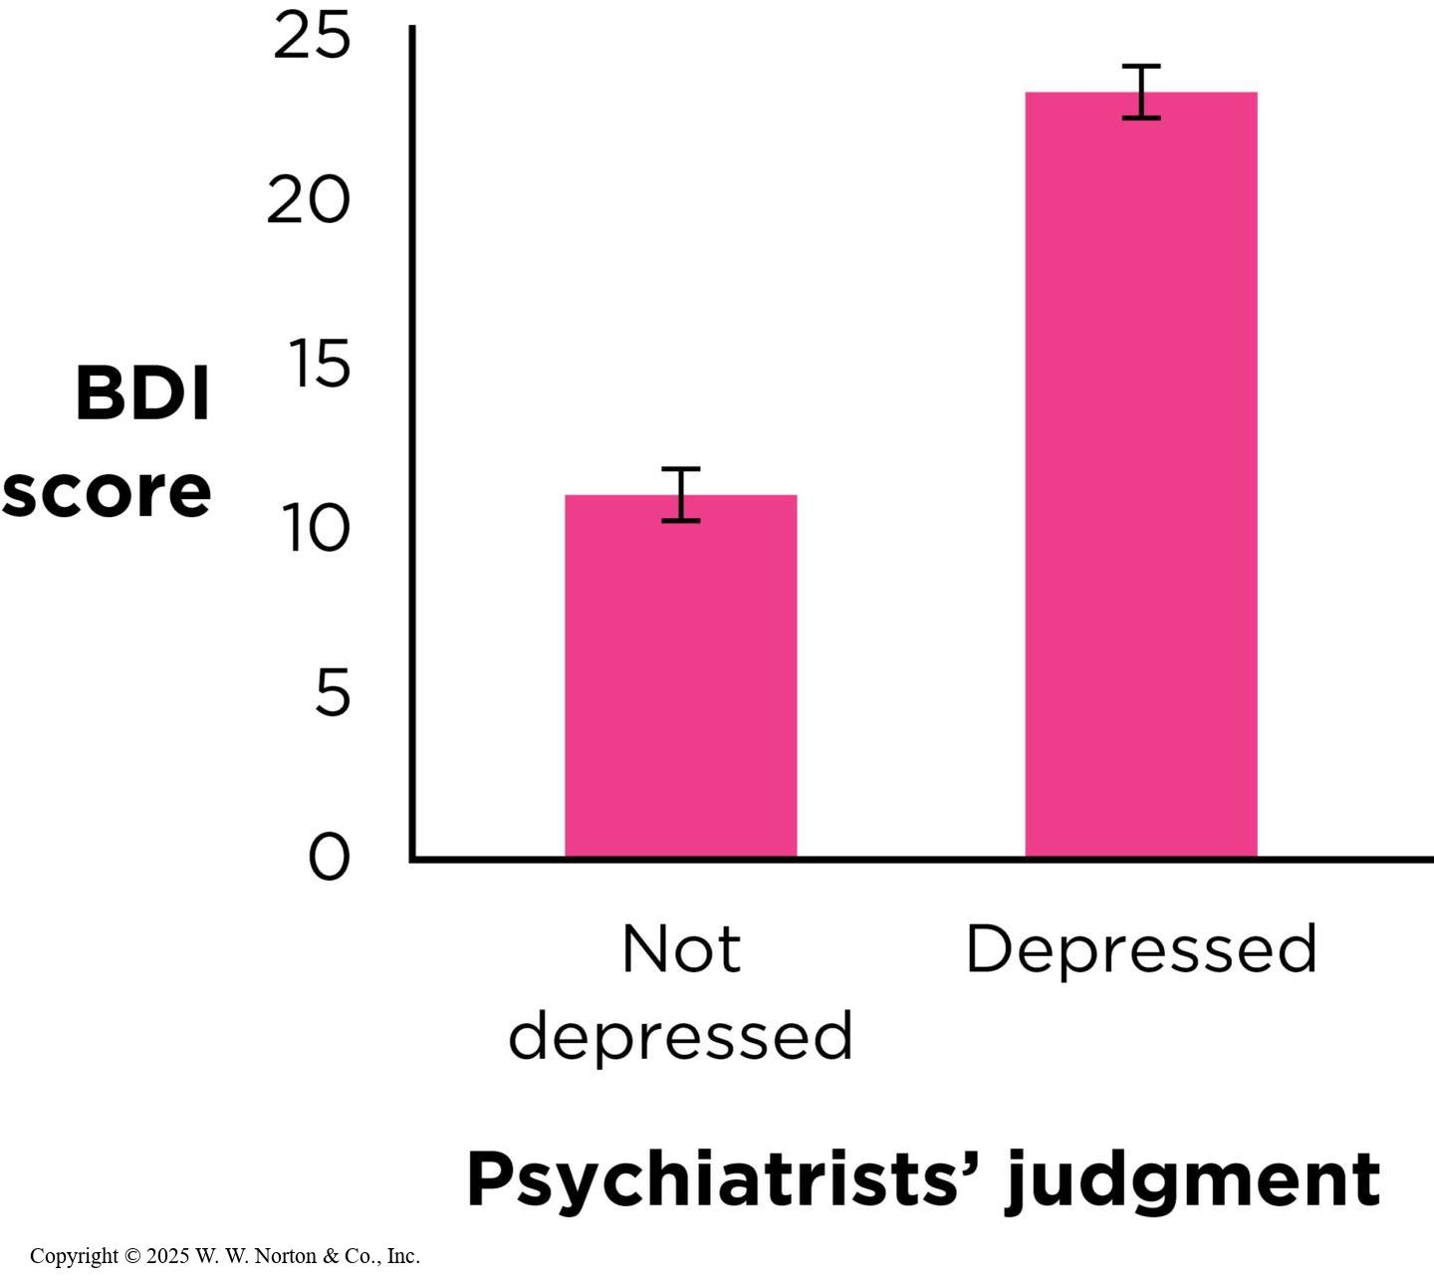
Known-Groups Evidence for Criterion Validity (1 of 2)
  Another way to gather evidence for criterion validity is to use a known-groups paradigm.
Notes:
Figure 5.11: BDI Scores of Two Known Groups
This pattern of results provides evidence for the criterion validity of the BDI using the known-groups method. Clients judged to be more depressed by psychiatrists also had higher scores. Error bars indicate the standard error of each mean. (Source: Adapted from Beck et al., 1961.)
Copyright © 2025 W. W. Norton & Co., Inc.
Figure 5.12. BDI Scores of Four Known Groups
This pattern of results means it is valid to use BDI cutoff scores to decide whether a person has mild, moderate, or severe depression. (Source: Adapted from Beck et al., 1961.)
Criterion validity is typically represented with correlation coefficients, but it can also be demonstrated with a known-groups paradigm (in which you examine whether scores on the measure can distinguish among a set of groups whose behavior is already well understood).
Example: The Beck Depression Inventory (BDI) is a 21-item self-report scale with questions about symptoms of depression. In order to test the criterion validity of the BDI using the known-groups paradigm, one could administer the BDI to a group of people with depression and a group of individuals who were not depressed, as determined by four psychiatrists who had conducted clinical interviews and provided diagnoses. In the graph on the left, you can see that the average BDI score for the group without depression is lower than the average BDI score for the group with depression. Thus, BDI appears to have good criterion validity based on the known-groups method.
Beck also used the known-groups paradigm to calibrate scores on the BDI by having psychiatrists categorize participants into the following levels of depression: none, mild, moderate, or severe. If you look at the graph on the left, you will see that the mean BDI scores for each group increased along with the severity of their level of depression as diagnosed by psychiatrists.
Copyright © 2025 W. W. Norton & Co., Inc.

Slide 37
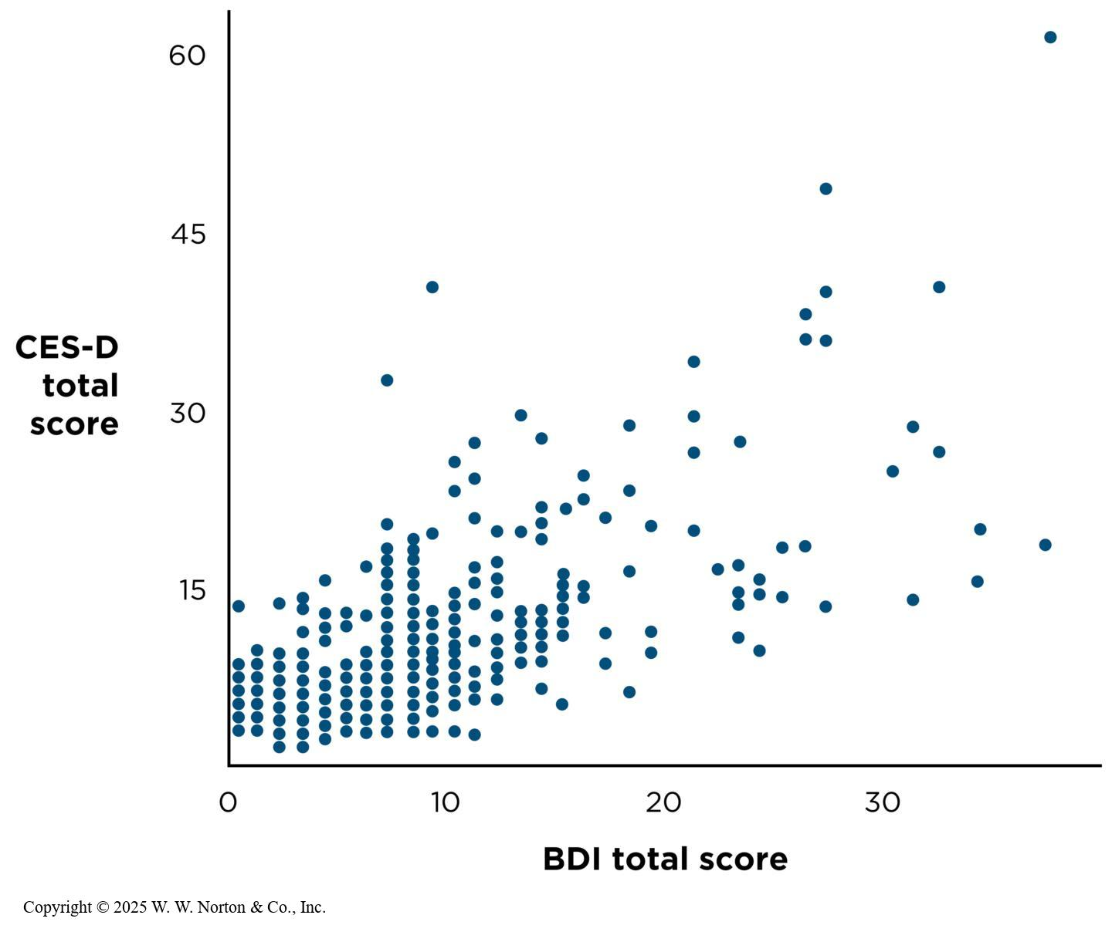
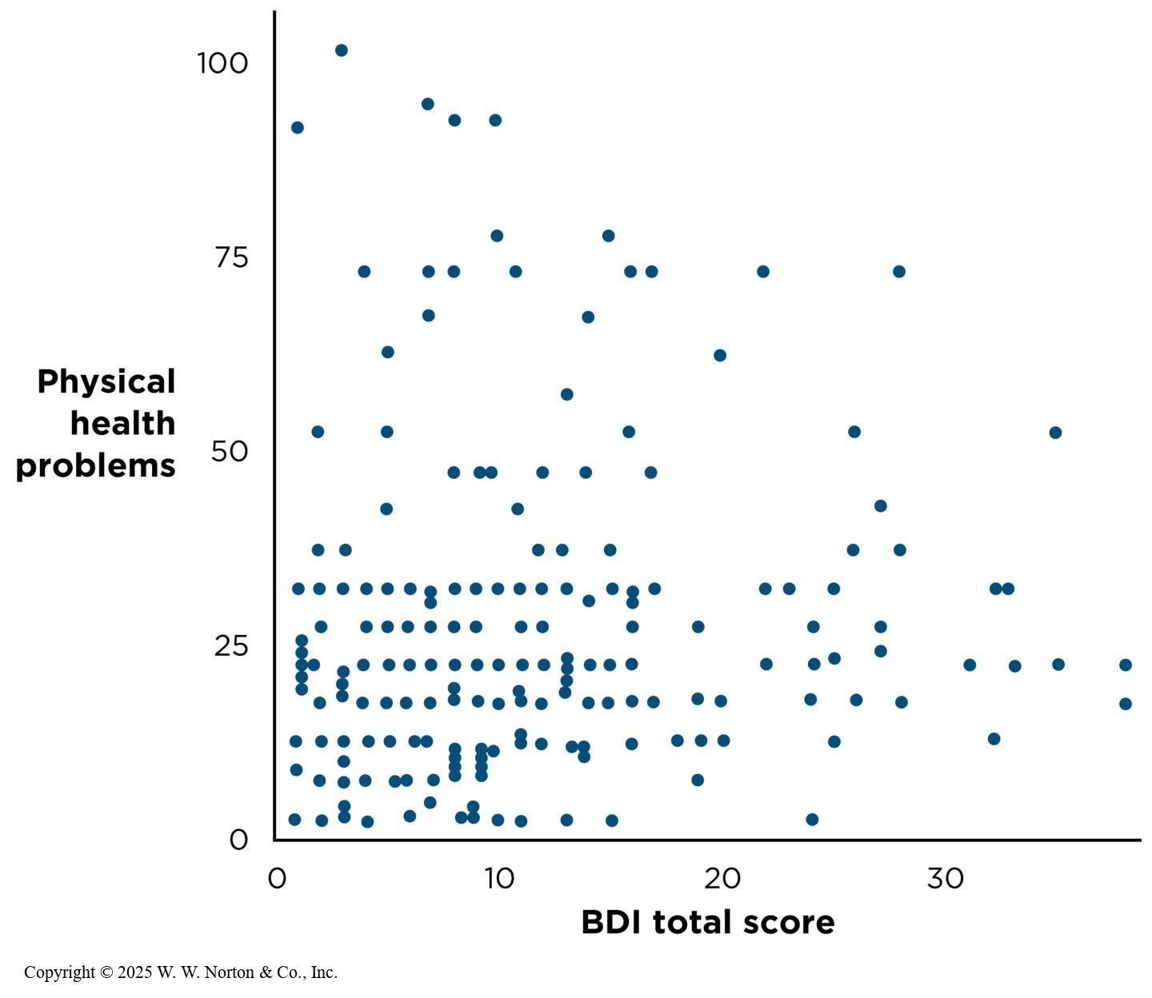
Convergent Validity and Discriminant Validity: Does the Pattern Make Sense?
  Convergent Validity
  Discriminant Validity
Notes:
Figure 5.13: Evidence Supporting the Convergent Validity of the BDI
The BDI is strongly correlated with another measure of depression, the CES-D (r = .68), providing evidence for convergent validity. (Source: Segal et al., 2008.)
Copyright © 2025 W. W. Norton & Co., Inc.
Figure 5.14: Evidence Supporting the Discriminant Validity of the BDI
As expected, the BDI is only weakly correlated with perceived health problems (r = .16), providing evidence for discriminant validity. (Source: Segal et al., 2008.)
Another type of validity is concerned with whether there is a meaningful pattern of similarities and differences.
Convergent validity: A measure should correlate strongly with other measures of the same construction; similarity. Figure 5.12, on the left, supports the convergent validity of the BDI with another measure of depression called the CES-D (Center for Epidemiologic Studies Depression scale). The two measures had a correlation coefficient of r = .68.
Discriminant validity (aka divergent validity): A measure should correlate less strongly with measures of different constructs; in other words, there must be differences. Figure 5.13, on the right, supports the discriminant validity of the BDI with a score on a physical health measure. The BDI is weakly negatively correlated with physical health (r = .16).
Copyright © 2025 W. W. Norton & Co., Inc.

Slide 38
The Relationship Between Reliability and Validity
  The validity of a measure is not the same as its reliability.
  A measure can be less valid than it is reliable, but it cannot be more valid than it is reliable.
  Reliability is necessary but not sufficient for validity.
Notes:
Remember that just because a measure is reliable (e.g., head circumference) doesn’t mean it’s a valid measure of IQ.
Reliability: This refers to how well a measure correlates with itself.
Validity: This refers to how well a measure is associated with something else.
If a measure doesn’t even correlate with itself, then how can it be correlated with other variables?
Reliability is necessary for validity, but not sufficient.

